Slide 1

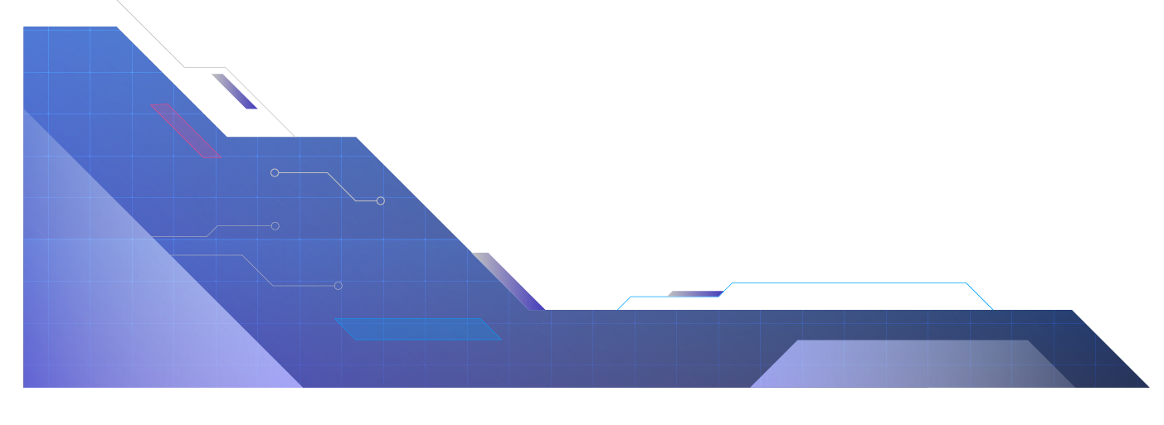

TRUSTED MULTI-CHANNEL NOTIFICATION SYSTEM
CAPSTONE PROJECT PRESENTATION
NAME: BHARGAB DAS
ROLL NO: CU.15
EMAIL ID: bhargabd40@gmail.com
MCA, COTTON UNIVERSITY

Slide 2

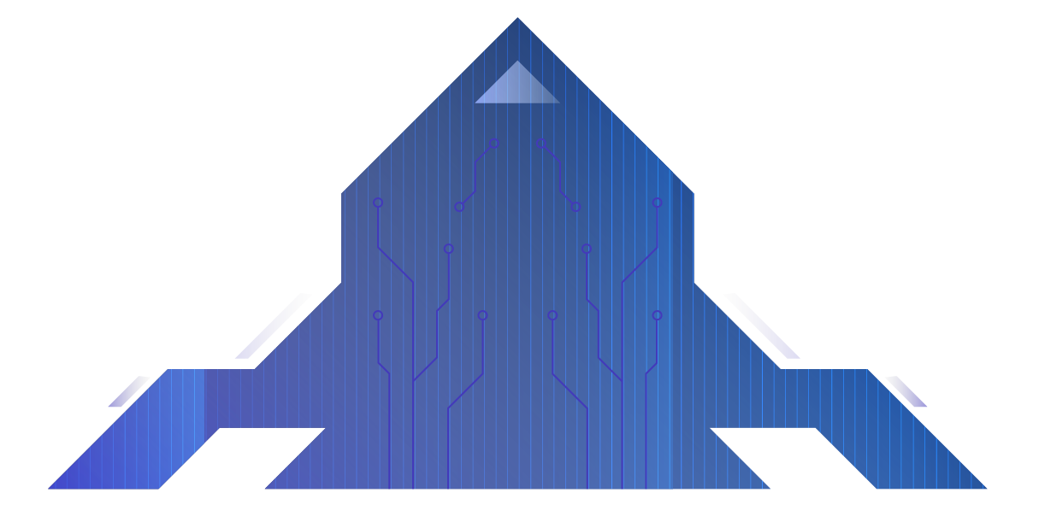
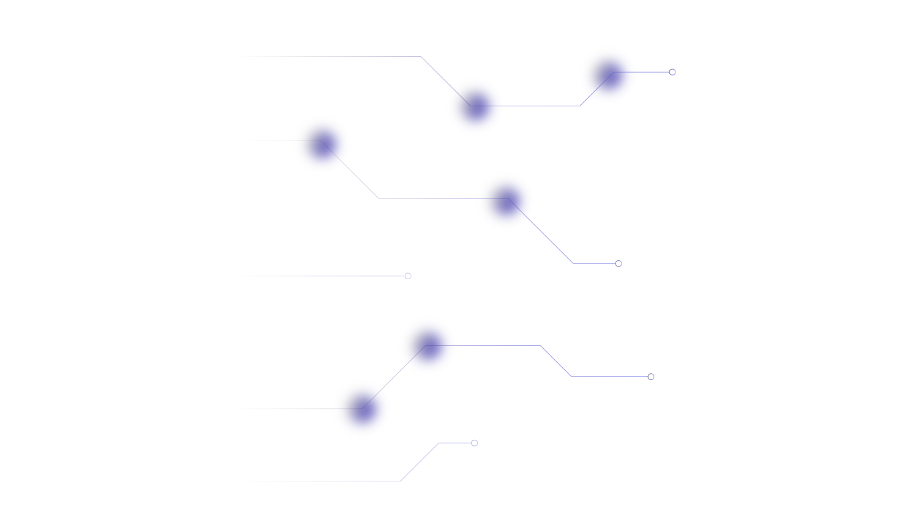
PROBLEM STATEMENT
Modern applications require reliable message delivery across multiple channels.
SMS failures due to network issues.
Push notifications need internet connectivity.
Emails may be delayed or marked as spam.
Banks need guaranteed alert & OTP delivery
with audit trails

Slide 3
PROJECT OBJECTIVE
Ensure notifications reach users via SMS, Push, or Email.
Automatic fallback when a channel fails.
Provide real-time event logs & analytics.
Modern UI dashboard with dark mode.
Modular system for future expansion.

Slide 4
SYSTEM ARCHITECTURE
Workflow Overview:
User triggers event from dashboard.
Dispatcher selects routing rule.
Sender Module attempts SMS → Push → Email.
Database logs each attempt.
Dashboard displays analytics & logs.

Slide 5
KEY FEATURES
Multi-channel notification delivery
Automatic fallback logic
Real-Time logs & analytics
Light/ Dark Mode UI
Secure & Modular architecture

Slide 6
ROUTINE Engine Logic
Fallback Ensures Maximum Delivery:
Try SMS
If SMS fails→ Try Push
If Push fails → Try Email
Log final result and attempt

Slide 7
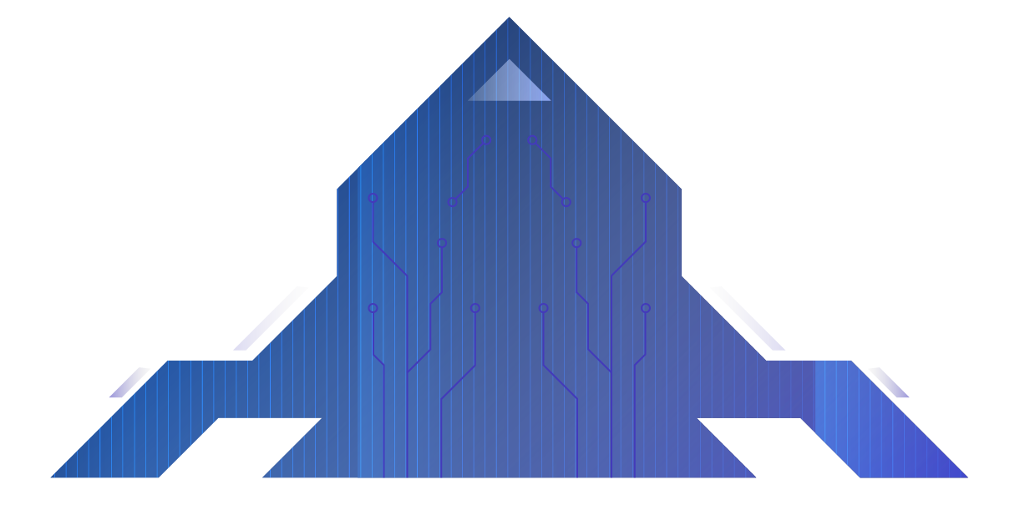
Dashboard Design
Tables
NotificationLog
Event_type, message, status, timestamp
Final_channel, attempts
ChannelAttempt
Channel, success/failure, reason, timestamp

Slide 8
Dashboard Overview
Tables:
NotificationLog:
Event_type, message, status, timestamp
Final_channel, attempts
ChannelAttempt:
Channel, success/failure, reason, timestamp

Slide 9
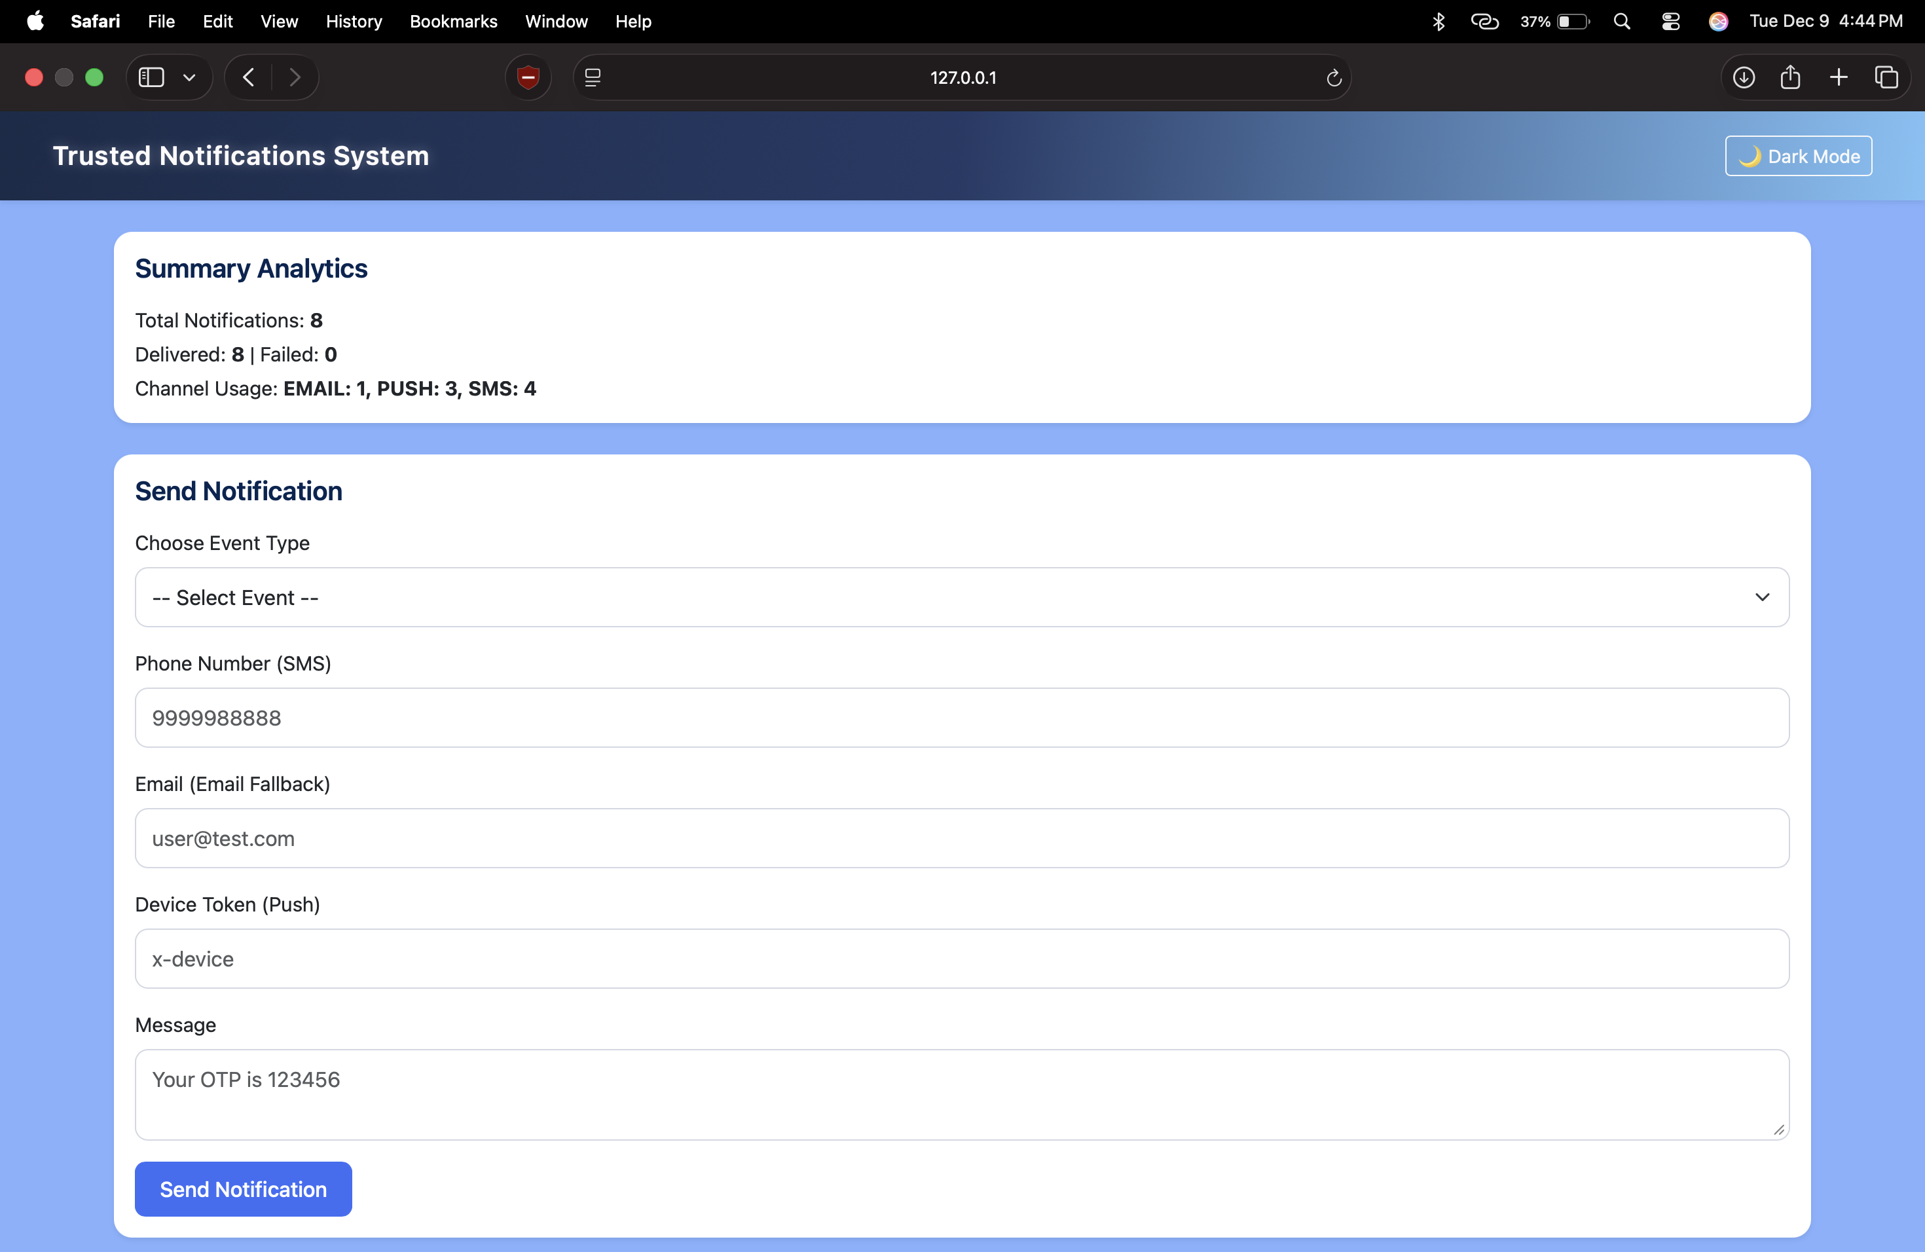
DASHBORD
DEMO

Slide 10
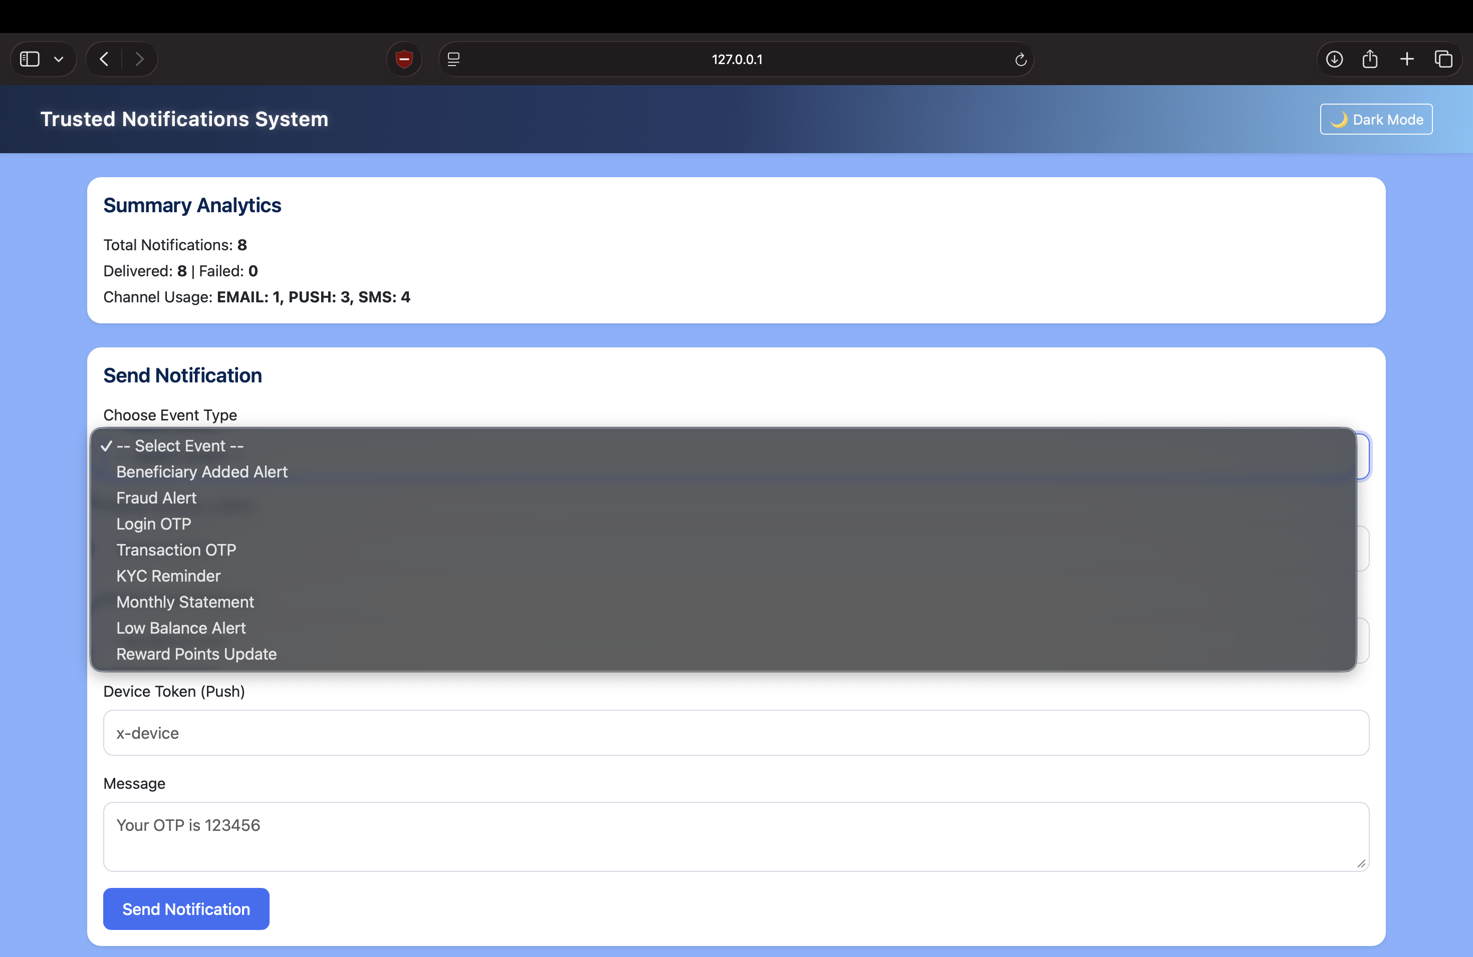
DASHBORD
DEMO

Slide 11
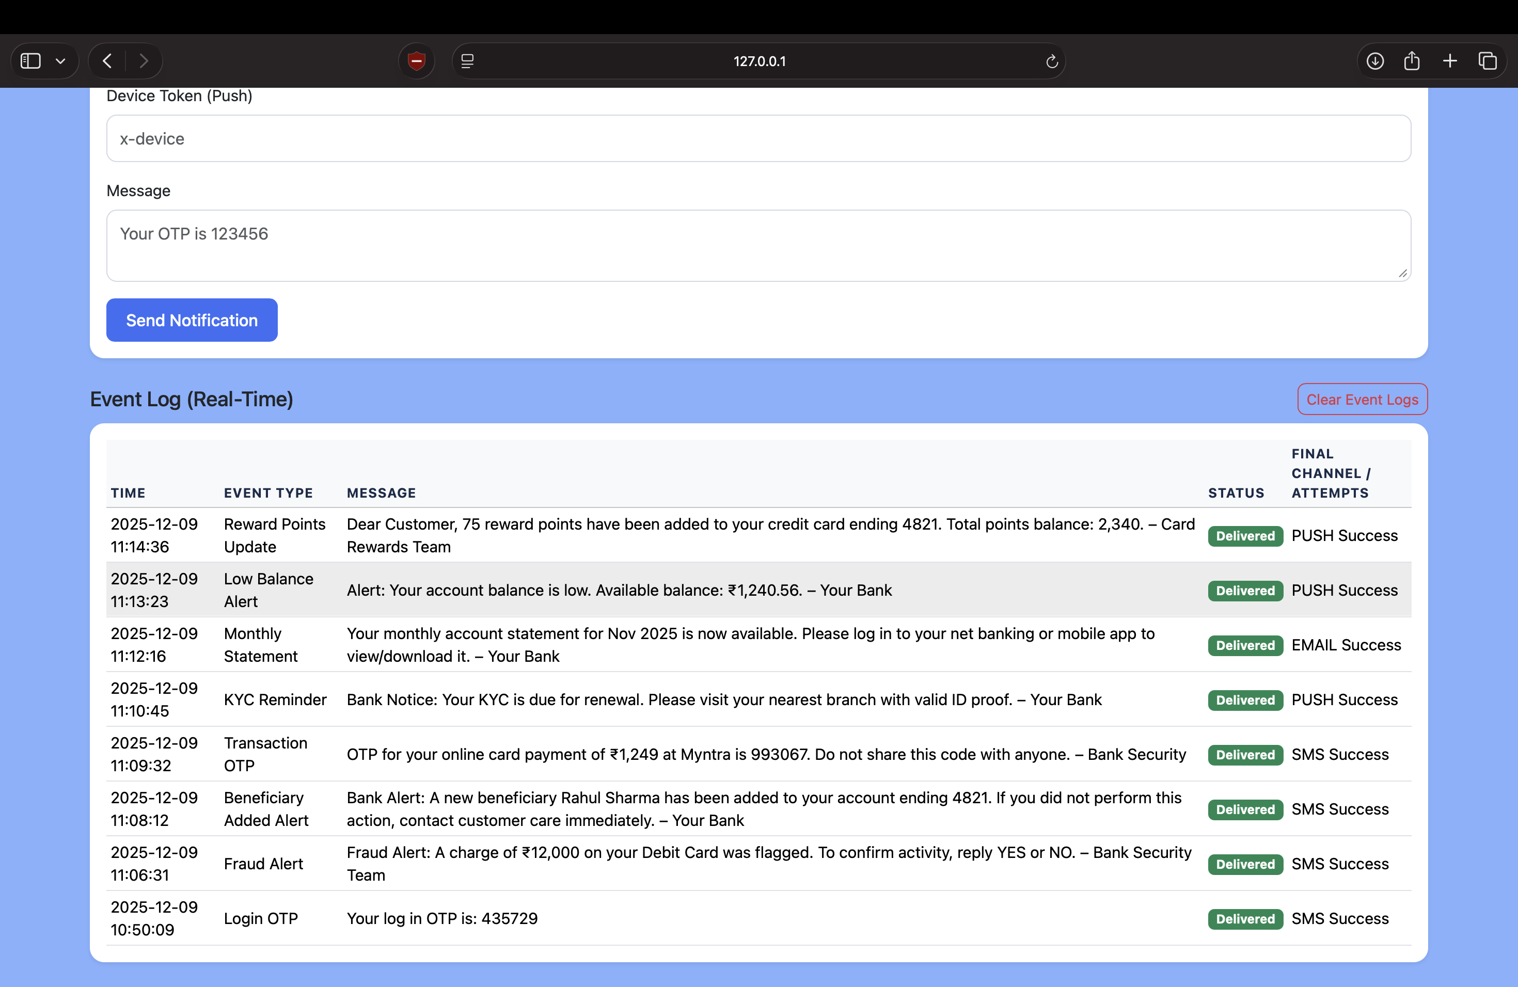
EVENT LOG VIEW

Slide 12


Dark Mode Features
Dark Mode Improves:
Visual comfort & accessibility
Readability during night usage
Professional banking-style UI

Slide 13
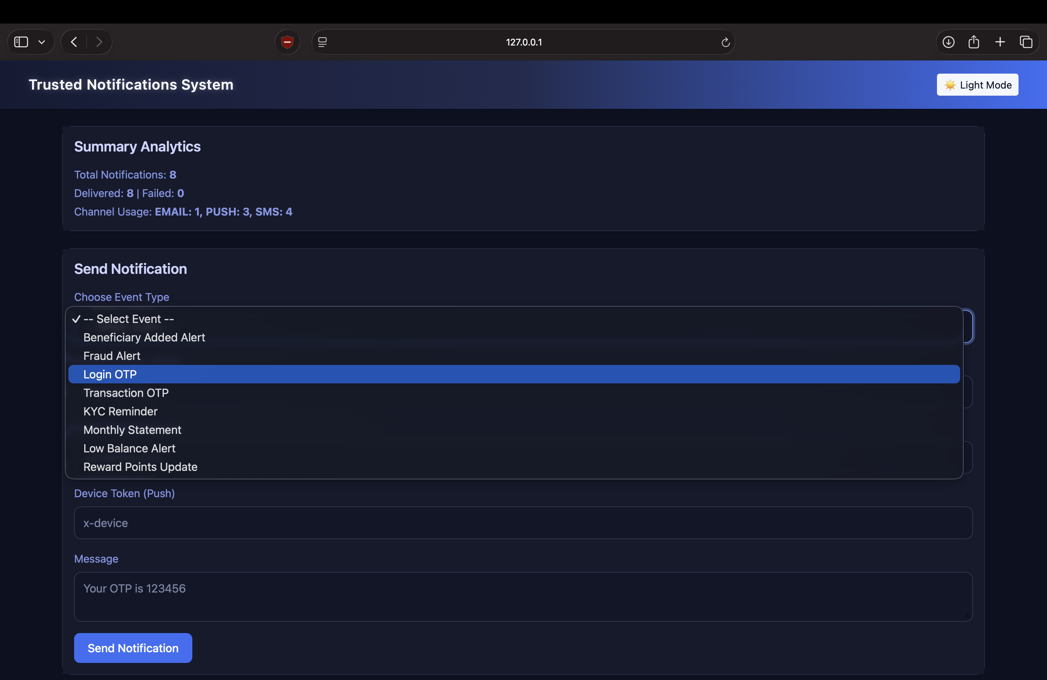
DARK MODE
DASHBORD
DEMO

Slide 14
Technologies Used
Python – Flask Framework
SQLite Database
SQLAlchemy ORM
Bootstrap 5 UI
JavaScript & Custom CSS

Slide 15
RESULT
High delivery reliability with fallback.
Clear visibility through real-time logs.
Modern responsive UI.
System replicates bank-grade notification flow.

Slide 16
CONCLUSION
Provides dependable multi-channel
Notification delivery.
Logs ensure transparency and traceability.
Scalable system ready for production APIs.

